Slide 1

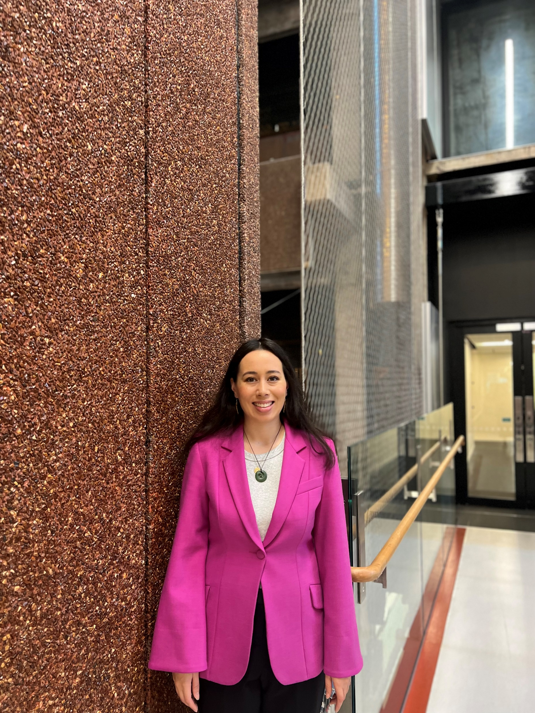
Lizzie Tafili
Student Support Adviser, Māori & Pacific
lizzie.tafili@auckland.ac.nz
027 – 561 - 5083
Building 301, Ground floor, Room 301 – G27.

Slide 2
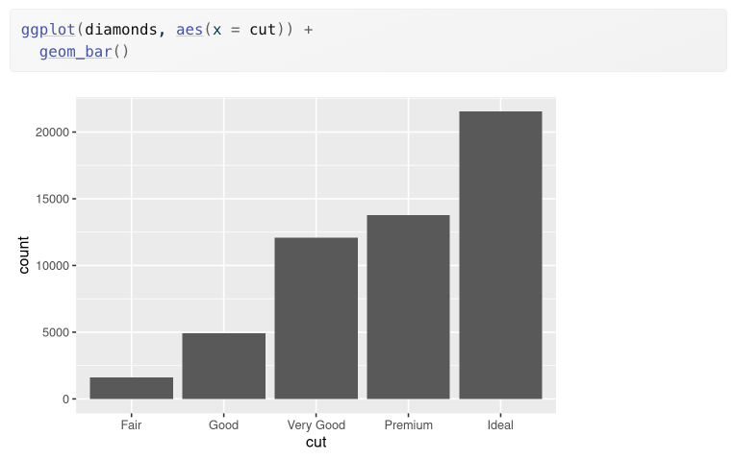
?diamonds in your console
Figure 1.
Source: https://r4ds.hadley.nz/layers.html

Slide 3
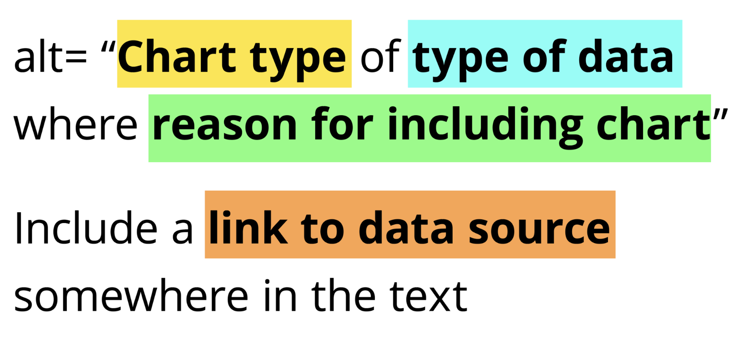
Source: https://nightingaledvs.com/writing-alt-text-for-data-visualization/

Slide 4
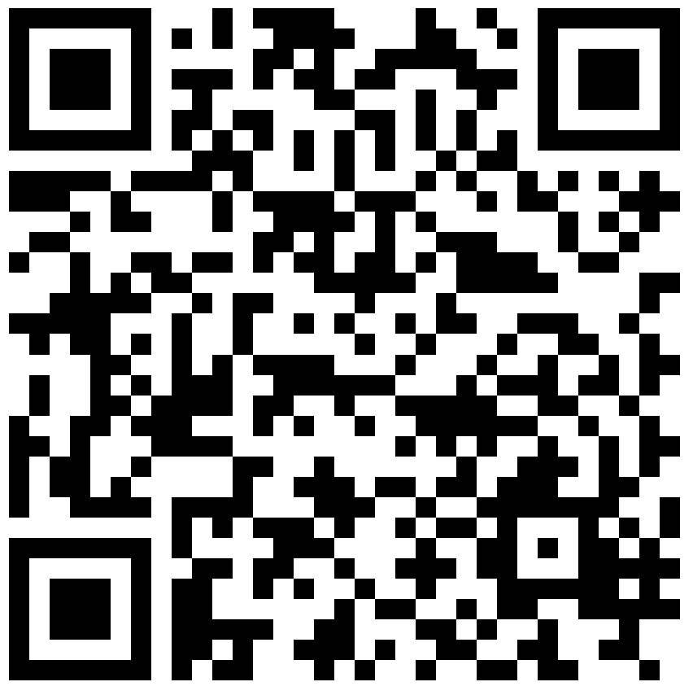
Write alt text for Figure 1
Go to link.lizabolton.com/slinky

Slide 5
What ethical considerations might data scientists have?
Go to link.lizabolton.com/slinky

